Slide 1
For Live Session Assignment (FLS)
Unit 6

Slide 2
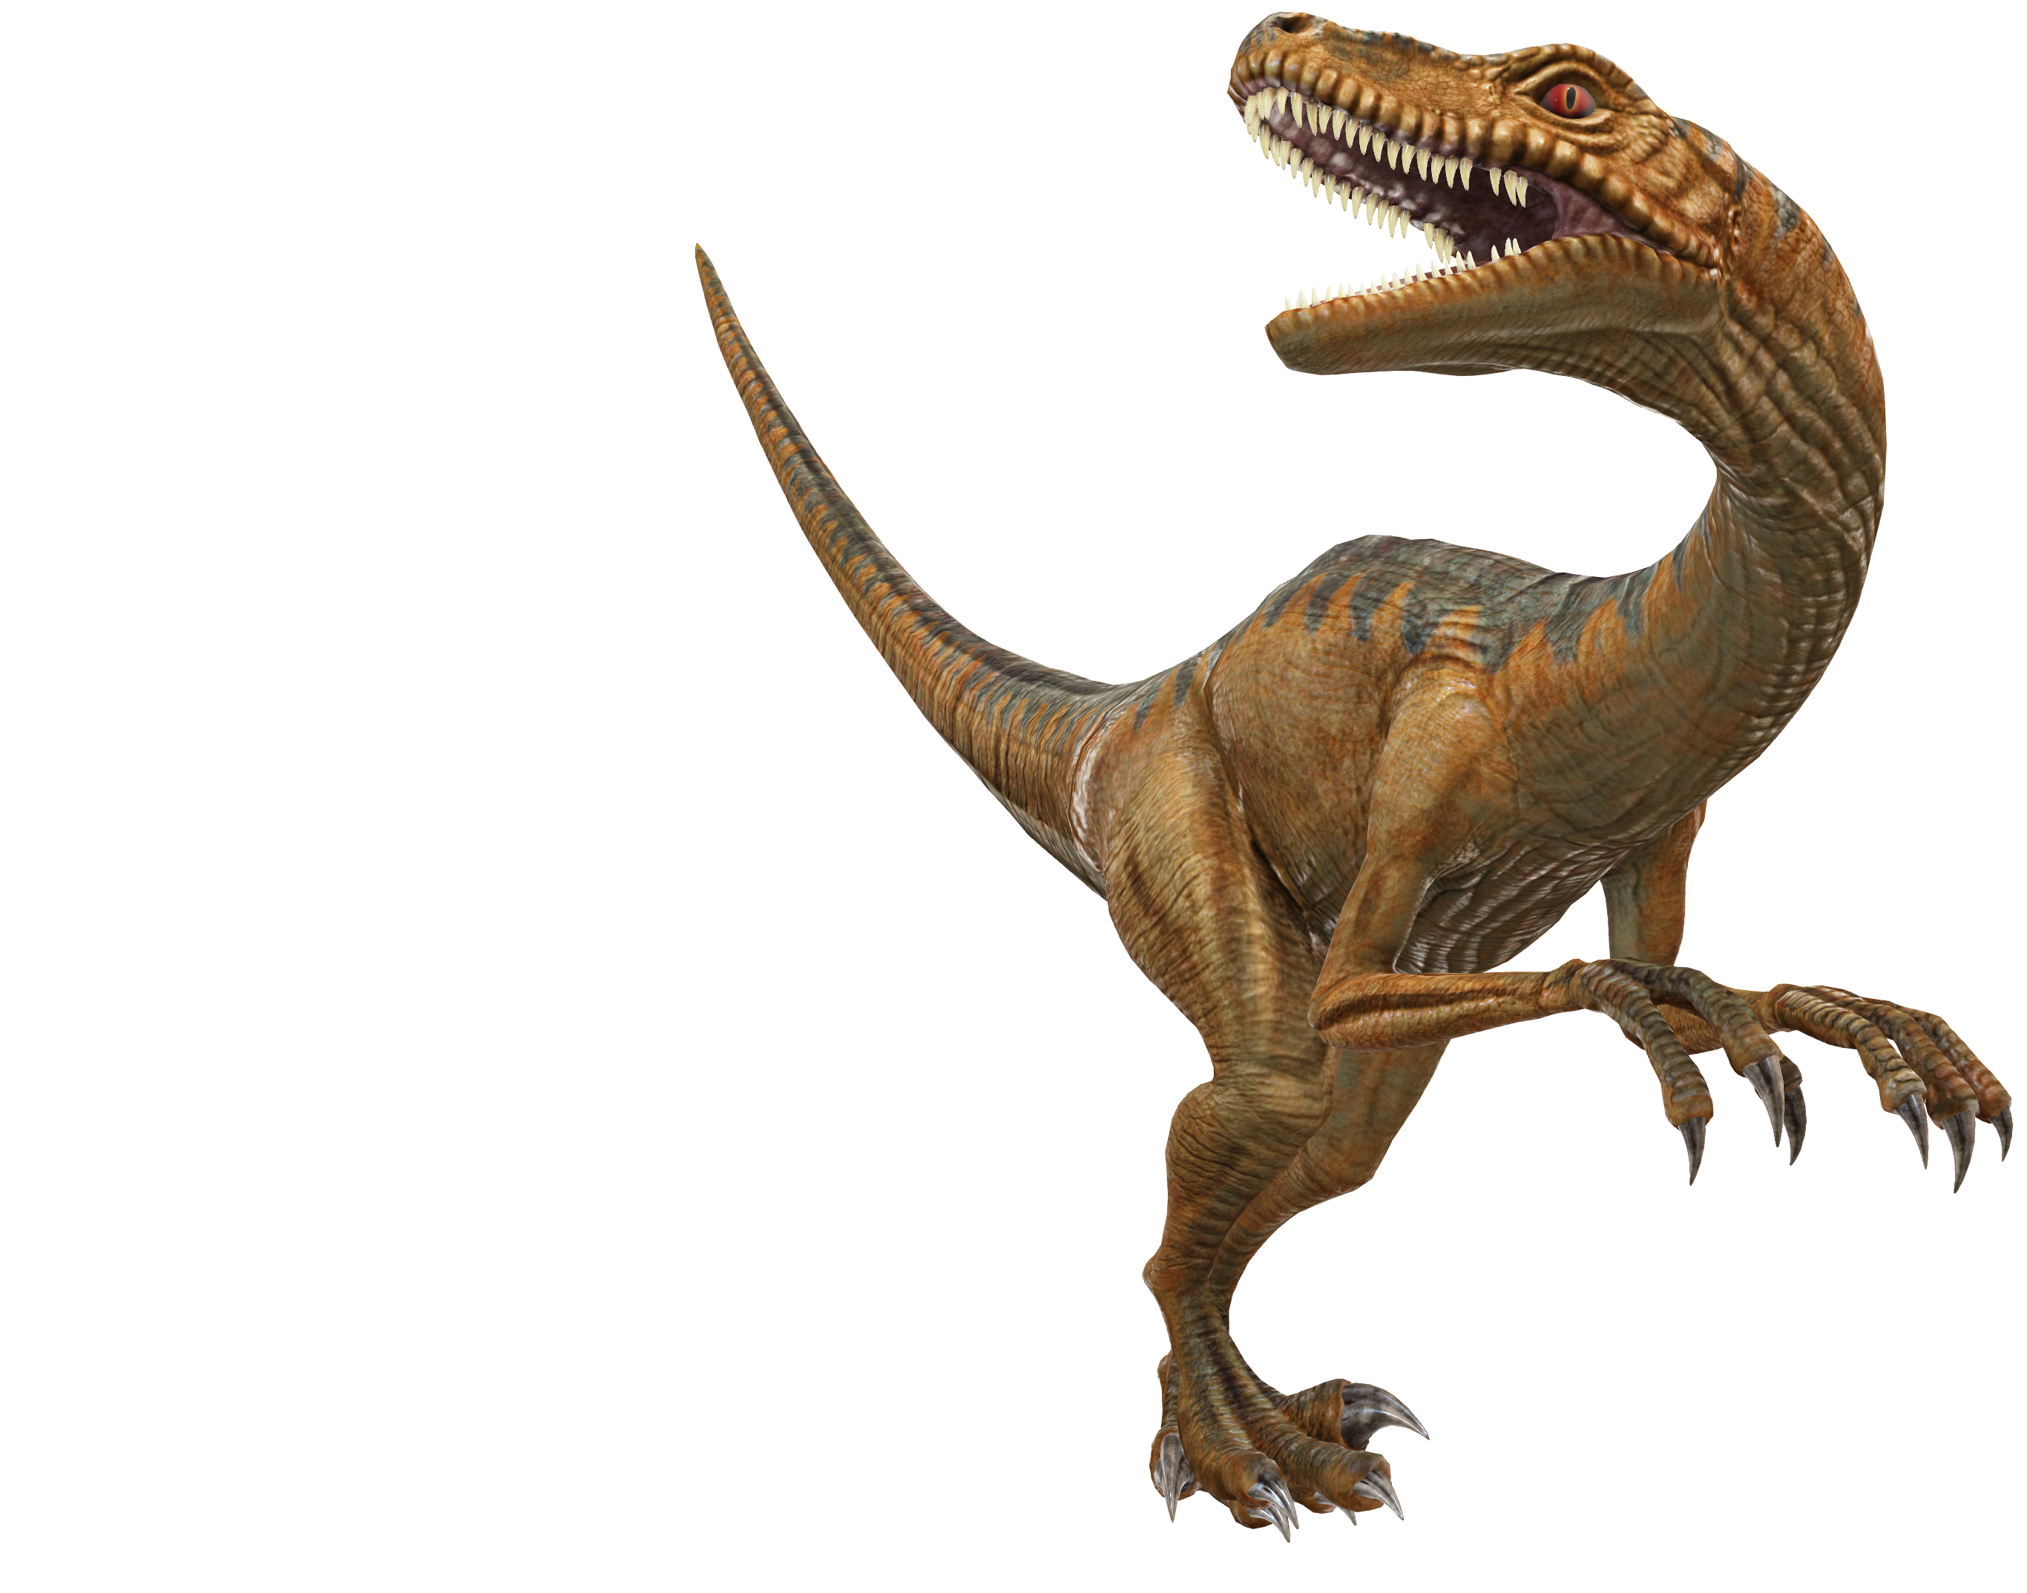
FLS 6

Slide 3
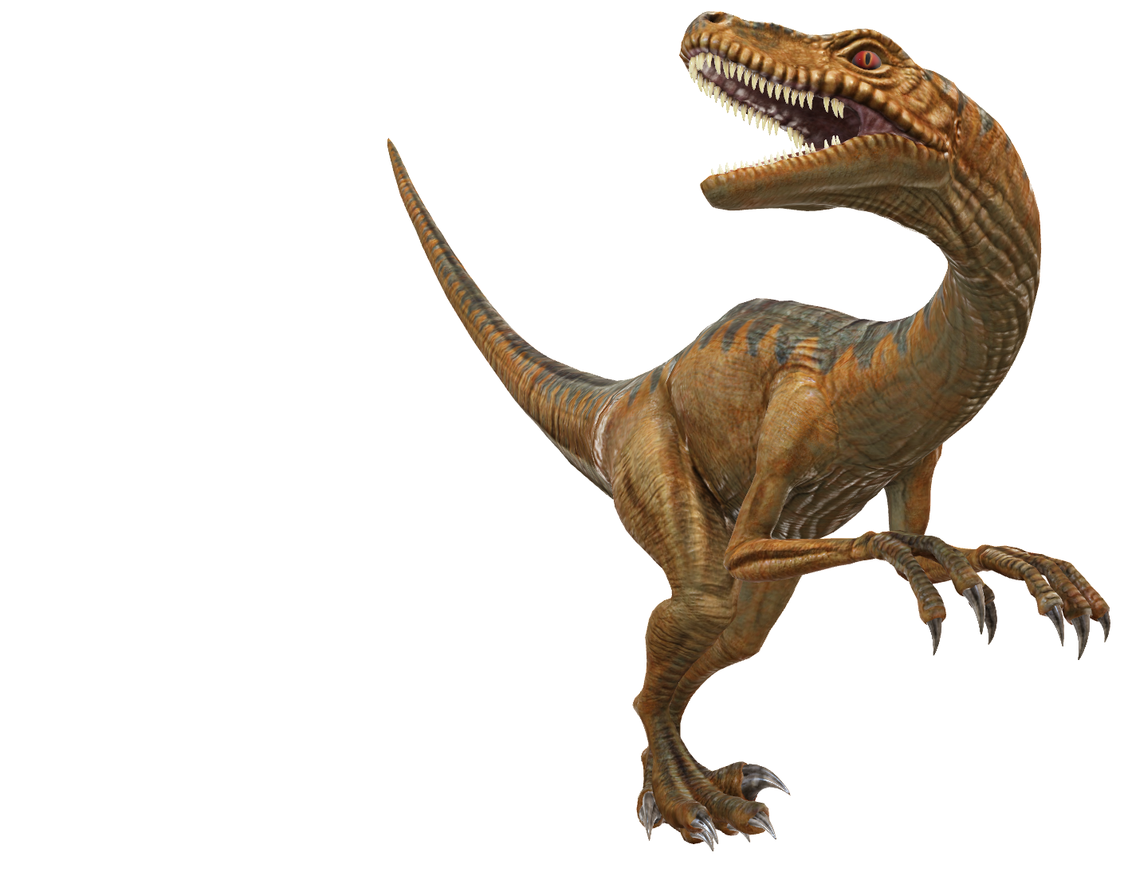
Estimate of the Error (SD / Variance)

Slide 4
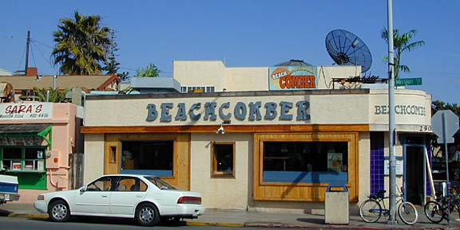
Example: 1 Sample t-test
The following are ages of 7 randomly chosen patrons seen leaving the Beach Comber in South Mission Beach at 7pm! We assume that the data come from a normal distribution and would like to test the claim that the mean age of the distribution of Comber patrons is different than 21. Conduct a 6 step one sample 2-sided t-test with alpha = .05 to test this claim. Provide enough explanation to fully describe each step. Recall that Step 2 is finding the critical value which is the same as the t multiplier in the corresponding 95% confidence interval.
25, 19, 37, 29, 40, 28, 31

Slide 5

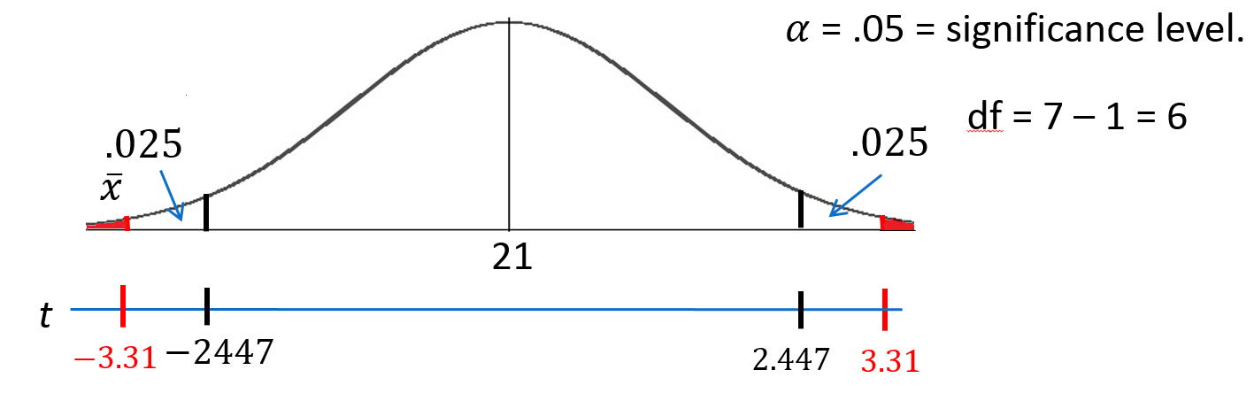
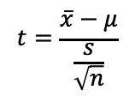
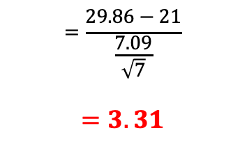
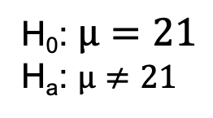
Let’s Formalize This Test Into 6 Steps!
We would like to test the claim that the population mean is not equal to 21. To do this, we take a sample of size n = 7 and find that $\overline{x}$ = 29.86 years and s = 7.09 years.
H₀: $µ=21$
H_{a}: $µ≠21$
Step 1: Identify the null (H₀) and alternative (H_{a}) hypothesis.
Step 2: Draw and Shade and Find the Critical Value.
$$=\frac{29.86−21}{\frac{7.09}{\sqrt{7}}}$$
$$=3.31$$
$$t=\frac{\overline{x}−μ}{\frac{s}{\sqrt{n}}}$$
Step 3: Find the test statistic. (The t value for the data.)
Step 4: Find the p-value: P-value 0.0162 < 0.05
Step 5: REJECT H₀
Step 6: There is sufficient evidence to conclude that the true mean age of patrons at the Comber at 7pm is not equal to 21 (p-value =0.0162 from a t-test). We could also say that there is sufficient evidence to conclude that the true mean is greater than 21. (Consider the red area in the right most tail.) This was not a random sample of all times, only at 7pm; thus, the result cannot be applied to the bar at all times. The results are nevertheless intriguing.

Slide 6
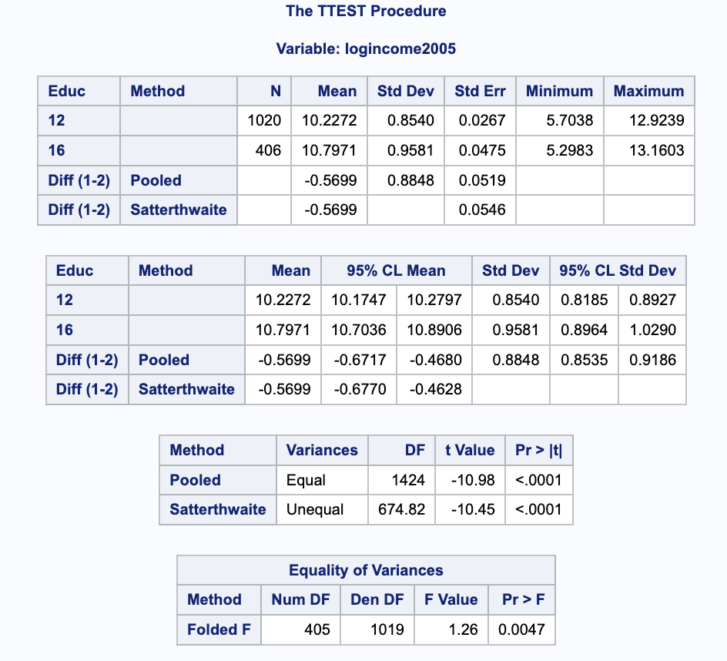
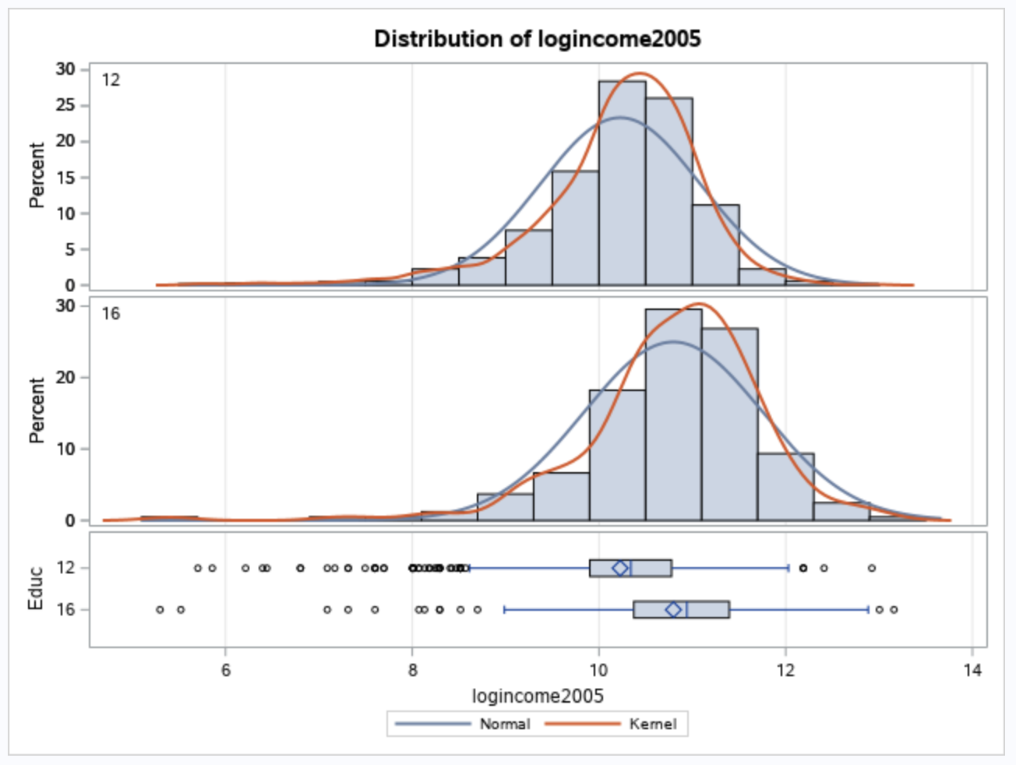
Pooled Estimate of the Error (SD / Variance) 2 Group Test

Slide 7
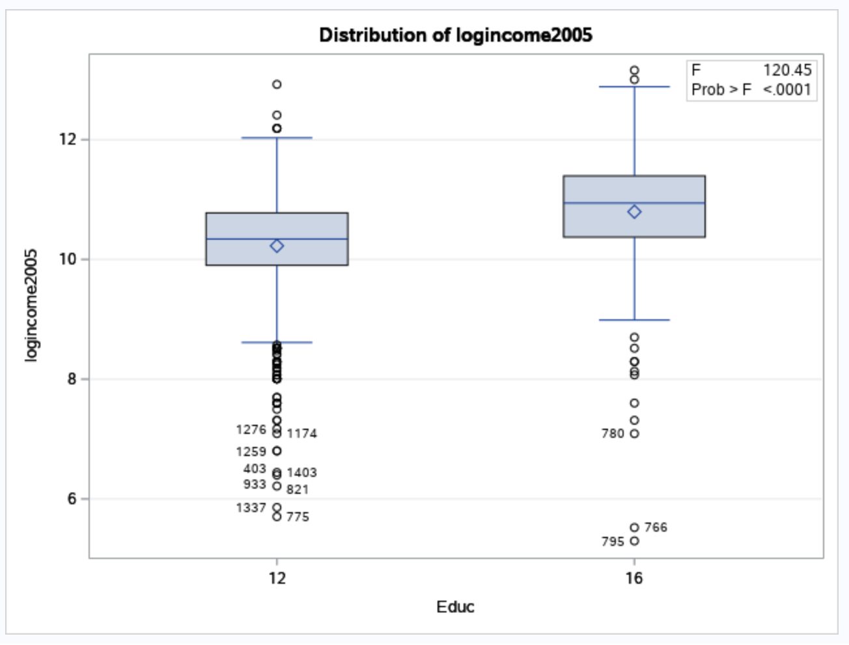
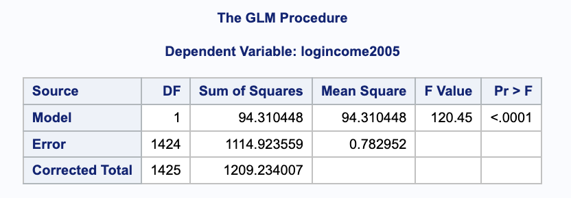
Pooled Estimate of the Error (SD / Variance) 2 Group Test
proc glm data = educ;
class educ;
model logincome2005 = educ;
run;

Slide 8
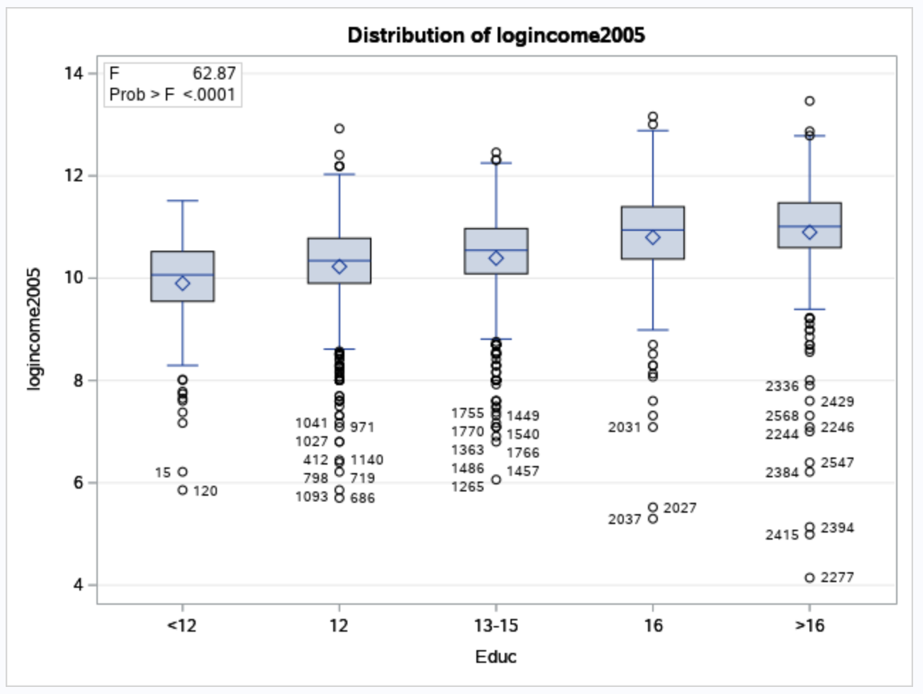
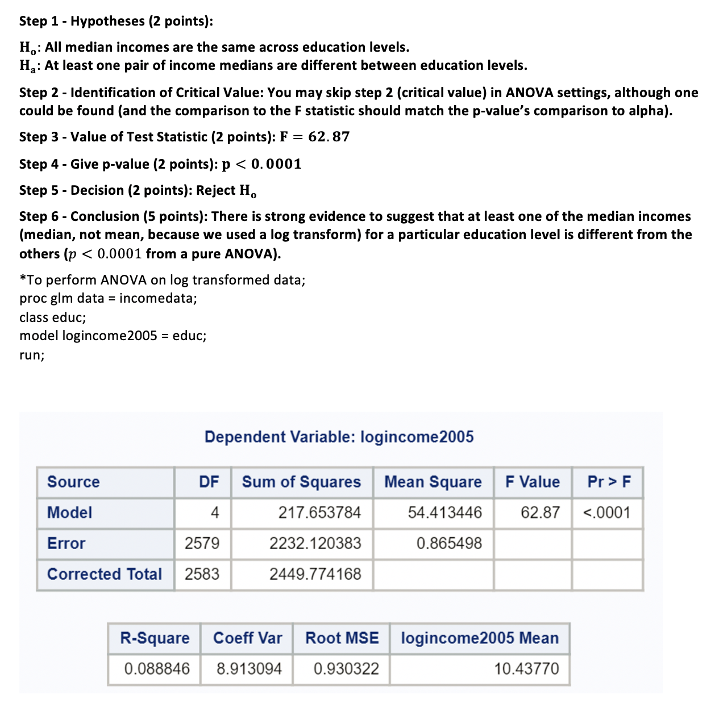
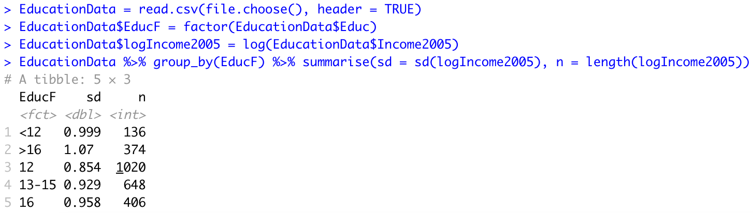
Pooled Estimate of the Error (SD / Variance) (5 Group Test)
proc glm data = educ;
class Educ;
model logincome2005 = educ;
run;
Notes:
EducationData = read.csv(file.choose(), header = TRUE)
EducationData$EducF = factor(EducationData$Educ)
EducationData$logIncome2005 = log(EducationData$Income2005)
EducationData %>% group_by(EducF) %>% summarise(sd = sd(logIncome2005), n = length(logIncome2005))

Slide 9
Question 1: Quick Quiz Questions

Slide 10
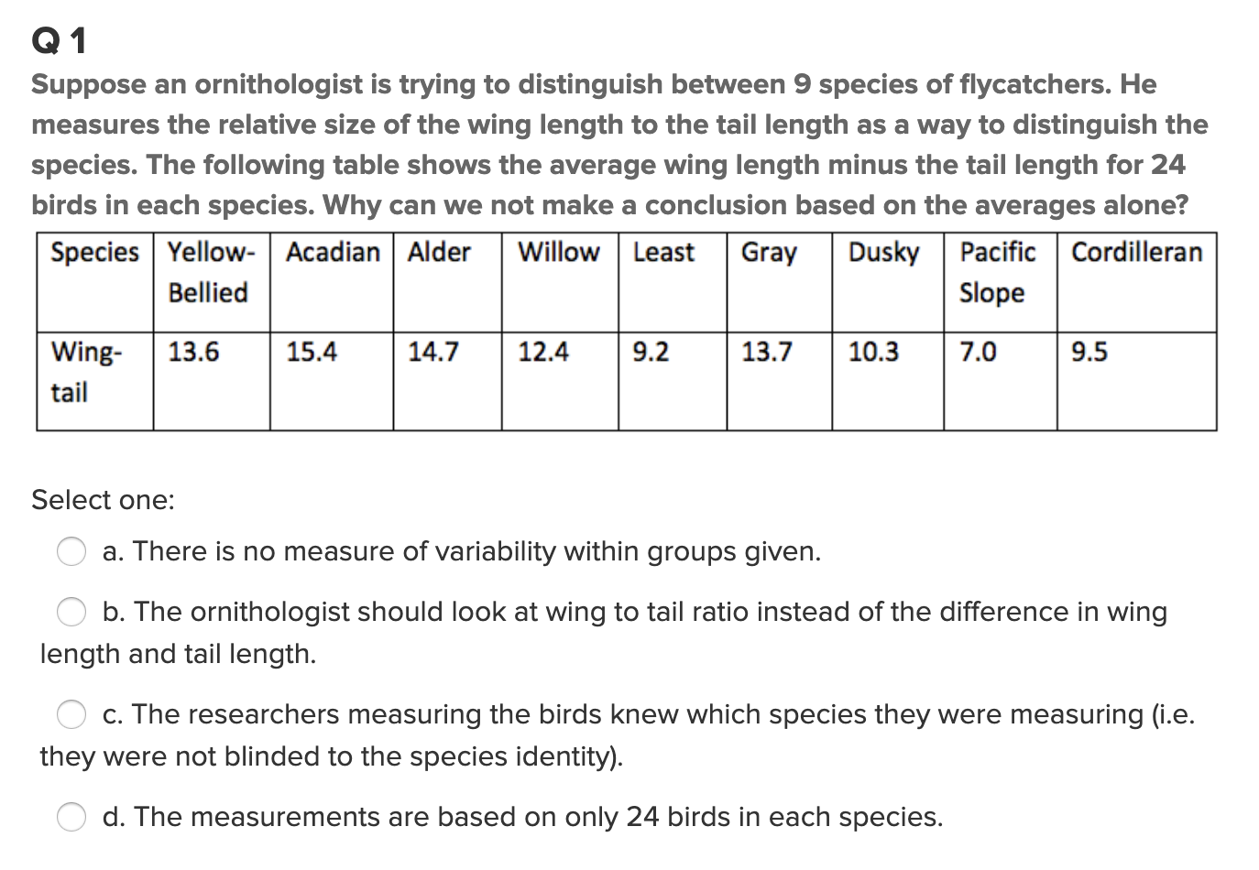
Question 1 (<15 min)

Slide 11
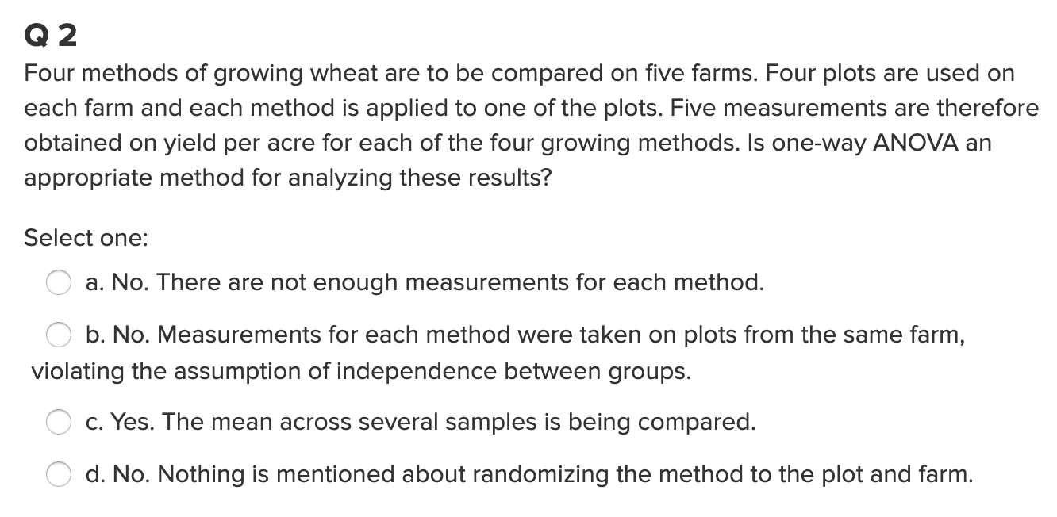
Question 2 (< 15 min)

Slide 12
End Question 1: Quick Quiz Questions

Slide 13

Question 2 ($≤2$ hours)

Slide 14
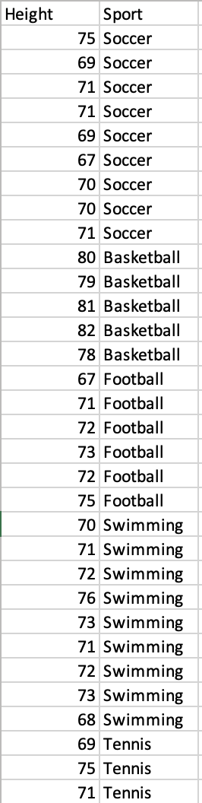

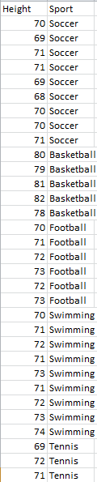
Height!
5 different sports were analyzed to see if the average height of basketball players was greater than the average of all the other sports. We could, of course, compare each pairwise grouping of sports, but that would result in 4 tests. This would take a lot of time, and those tests would each have less power since they don’t use all the data. Let’s use ANOVA similarly to how we did in prior problems.
Make a side by side box plot of the data.
Run a basic ANOVA to test for any pairwise difference of means between any of the 5 sports. Check the assumptions here, but no need to address them after this.
Conduct an Extra Sum of Squares test to test the following hypothesis:
Depending on the results of this test, test to see if there is evidence that basketball has a different mean than each of the sports. (Equivalent to testing basketball versus the others.). This is similar to the Spock example.
Make sure and provide written conclusions for questions 2,3,4 and 5.
H_{o}: Reduced Model: µ_{B} µ_{O} µ_{O} µ_{O} µ_{O}
H_{a}: Full Model: µ_{B} µ_{F} µ_{Soc} µ_{Swim} µ_{T}
H_{o}: Reduced Model: µ_{O} µ_{O} µ_{O} µ_{O} µ_{O}
H_{a}: Full Model: µ_{B} µ_{O} µ_{O} µ_{O} µ_{O}

Slide 15
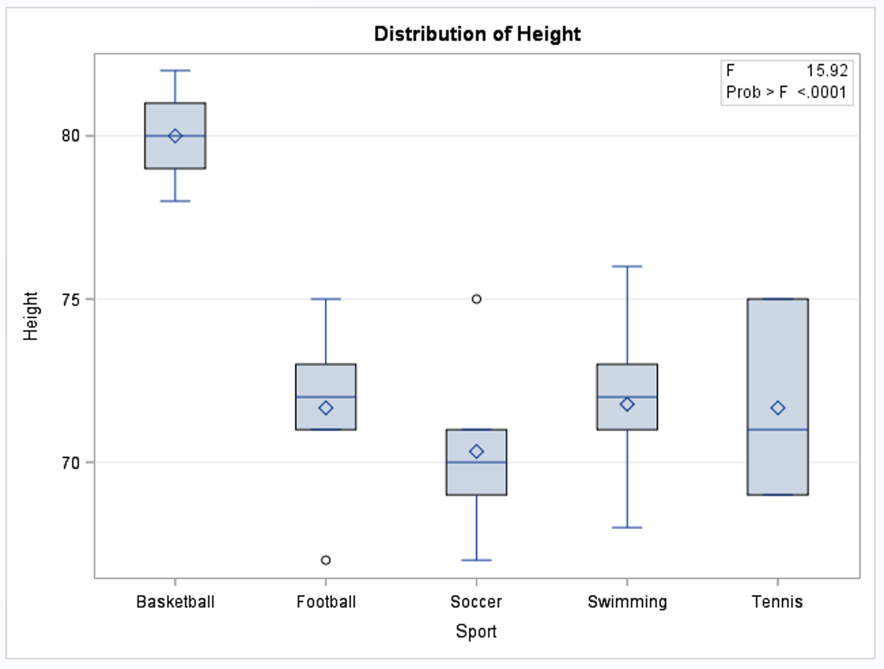
First … Plot the Data!
proc glm data = SportHeight;
class Sport;
model Height = Sport / solution;
run;

Slide 16
Boxplot in R
Sports %>%
ggplot(aes(x = Sport, y = Height, color = Sport)) + geom_boxplot() +
ggtitle("Height Distributions Based on Sport")

Slide 17
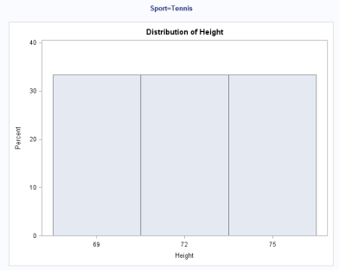
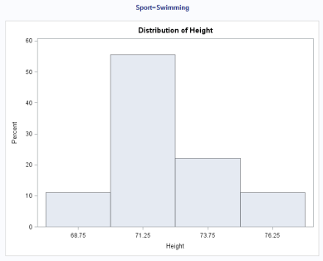
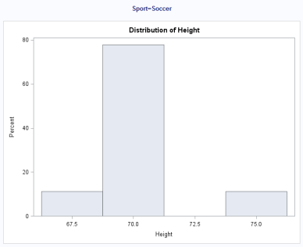
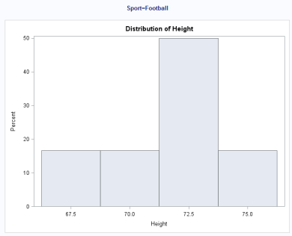
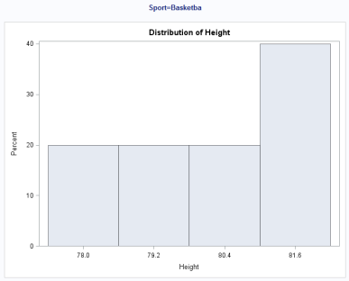
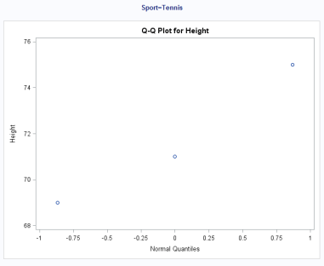
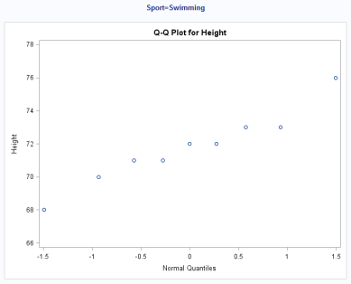
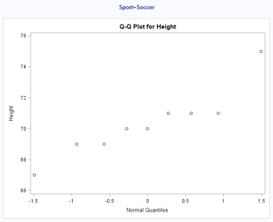
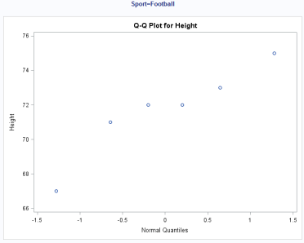
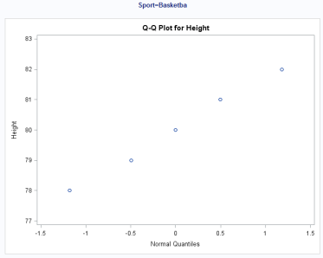
Plot the Data cont.
proc glm data = SportHeight;
class Sport;
model Height = Sport / solution;
run;
proc sort data = SportHeight;
by Sport;
run;
proc univariate data = SportHeight;
by Sport;
histogram Height;
qqplot Height;
run;
Normality: We have very small sample sizes here. There is not a lot of evidence against normality for each group, although there is not a lot of evidence to begin with. We will proceed with caution under the assumption of normal distributions for each sport.
Homogeneity of Variance: Judging from the box plots, there is some visual evidence against equal standard deviations, although the sample size is still small. A secondary test would be nice to lean on here.
We will assume the observations are independent both between and within groups.

Slide 18
Histograms and Qqplots in Plots in R
Sports %>%
ggplot(aes(x = Height, color = Sport)) + geom_histogram() +
ggtitle("Height Distributions Based on Sport") + facet_wrap(~Sport)
Sports %>%
ggplot(aes(sample = Height, color = Sport)) + geom_qq() +
geom_qq_line() +
ggtitle("QQplots of Heigth Based on Sport") + facet_wrap(~Sport)

Slide 19
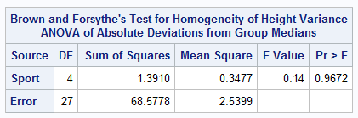
Brown and Forsythe Test for Equality of Variance.
proc glm data = SportHeight;
class Sport;
model Height = Sport / solution;
means Sport / hovtest = bf;
run;
There is some visual evidence against equal standard deviations between sports. The Brown and Forsythe test was used as secondary evidence and does not provide significant evidence against equal standard deviations. (p-value from the Brown and Forsythe Test = .9672)

Slide 20
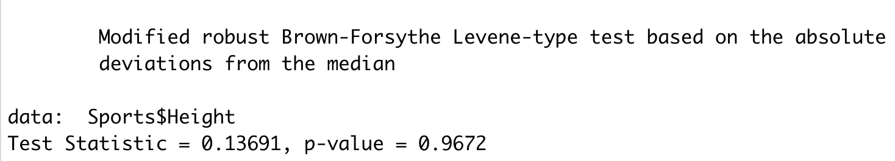
Brown-Forsythe Test in R
library(lawstat)
levene.test(Sports$Height,Sports$Sport)
There is some visual evidence against equal standard deviations between sports. The Brown and Forsythe test was used as secondary evidence and does not provide significant evidence against equal standard deviations. (p-value = .9672)

Slide 21
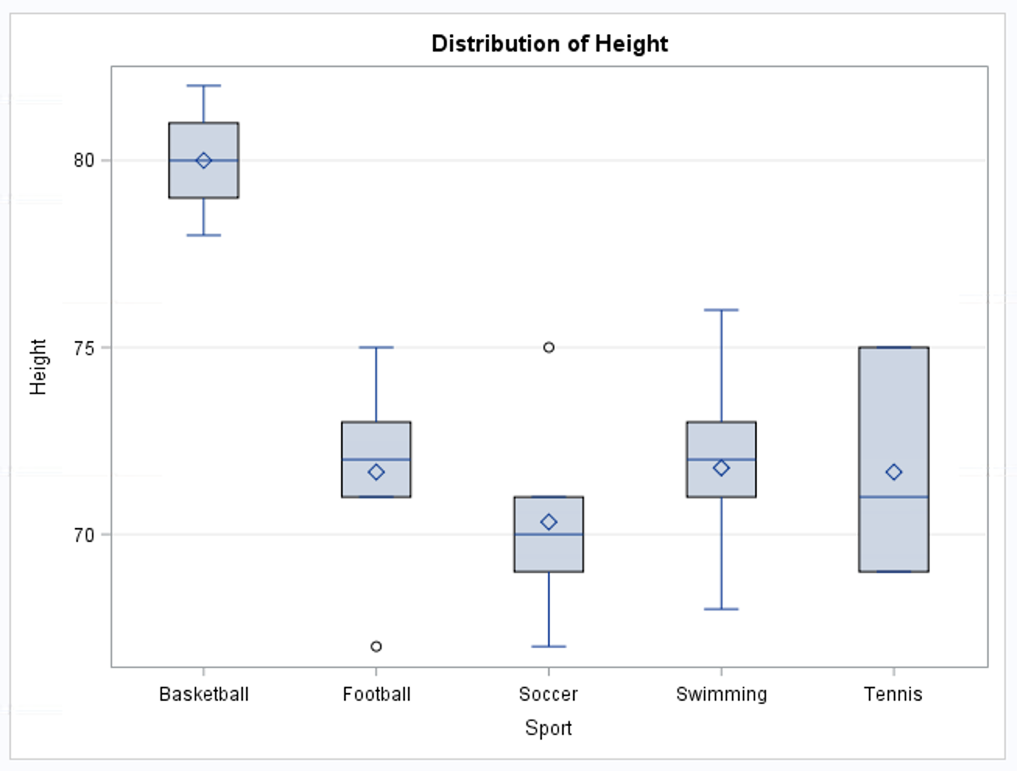
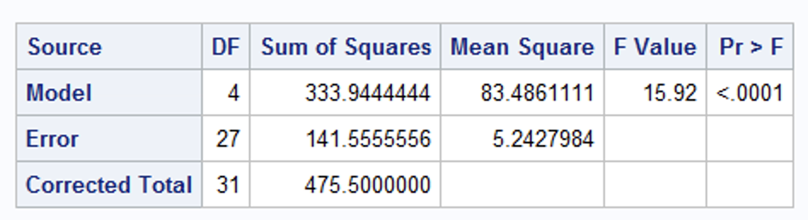
1 Way ANOVA
H₀: µ_{Basketball} = µ_{Football}= µ_{Soccer} = µ_{Swim} = µ_{Tennis}
H_{a}: At least one pair of means is different.
proc glm data = SportHeight;
class Sport Combine;
model Height = Sport / solution;
means Sport / hovtest = bf;
run;
There is strong evidence to suggest that the at least one of the sports has a mean height that is different than the others (p-value < .0001 from an ANOVA).

Slide 22
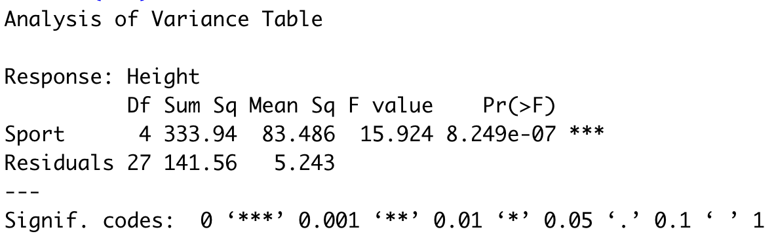
1 Way ANOVA
H₀: µ_{Basketball} = µ_{Football}= µ_{Soccer} = µ_{Swim} = µ_{Tennis}
H_{a}: At least one pair of means is different.
fit = lm(Height~Sport, data = Sports)
anova(fit)
There is strong evidence to suggest that the at least one of the sports has a mean height that is different than the others (p-value < .0001 from an ANOVA).

Slide 23
Height!
5 different sports were analyzed to see if the average height of basketball players was greater than the average of all the other sports. We could, of course, compare each pairwise grouping of sports, but that would result in 4 tests. This would take a lot of time, and those tests would each have less power since they don’t use all the data. Let’s use ANOVA similarly to how we did in prior problems.
Make a side by side box plot of the data.
Run a basic ANOVA to test for any pairwise difference of means between any of the 5 sports. Check the assumptions here, but no need to address them after this.
Conduct an Extra Sum of Squares test to test the following hypothesis:
Depending on the results of this test, test to see if there is evidence that basketball has a different mean than each of the sports. (Equivalent to testing basketball versus the others.). This is similar to the Spock example.
Make sure and provide written conclusions for questions 2,3,4 and 5.
H_{o}: Reduced Model: µ_{B} µ_{O} µ_{O} µ_{O} µ_{O}
H_{a}: Full Model: µ_{B} µ_{F} µ_{Soc} µ_{Swim} µ_{T}
H_{o}: Reduced Model: µ_{O} µ_{O} µ_{O} µ_{O} µ_{O}
H_{a}: Full Model: µ_{B} µ_{O} µ_{O} µ_{O} µ_{O}

Slide 24
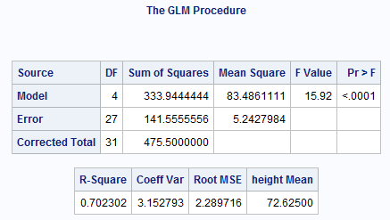
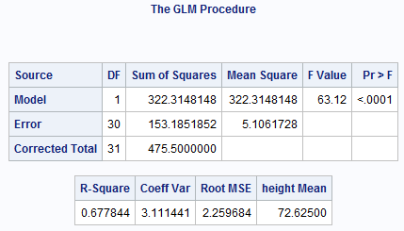
H₀: Reduced Model: µ µ µ µ µ
H_{a}: Full Model: µ_{B} µ_{F} µ_{Soc} µ_{Swim} µ_{T}
proc glm data = SportHeight;
class Sport;
model Height = Sport / solution;
means Sport / hovtest = bf;
run;
H₀: Reduced Model: µ µ µ µ µ
H_{a}: Full Model: µ_{B} µ_{O} µ_{O} µ_{O} µ_{O}
proc glm data = SportHeight;
class Sport Combine;
model Height = Combine / solution;
means Sport / hovtest = bf;
run;

Slide 25
Same Test as last slide ….
Different Notation
H₀: µ_{Basketball} = µ_{Football}= µ_{Soccer} = µ_{Swim} = µ_{Tennis}
H_{a}: At least one pair of means are different.
proc glm data = SportHeight;
class Sport;
model Height = Sport / solution;
means Sport / hovtest = bf;
run;
H₀: µ_{Basketball} = µ_{Football}= µ_{Soccer} = µ_{Swim} = µ_{Tennis}
H_{a}: µ_{Basketball} is different than the Others.
proc glm data = SportHeight;
class Sport Combine;
model Height = Combine / solution;
means Sport / hovtest = bf;
run;

Slide 26
µ_{B} µ_{F} µ_{Soc} µ_{Swim} µ_{T}
µ_{B} µ₀ µ₀ µ₀ µ₀
proc glm data = SportHeight;
class Sport Combine;
model Height = Combine / solution;
means Sport / hovtest = bf;
run;
proc glm data = SportHeight;
class Sport;
model Height = Sport / solution;
means Sport / hovtest = bf;
run;
F-TEST: Another Look
There is not sufficient evidence at the alpha = .05 level of significance (p-value = 0.5375) to suggest that the mean heights of non-basketball sports are different. Therefore we will proceed as if they are equal.
H₀: Reduced Model: µ_{B} µ₀ µ₀ µ₀ µ₀
H_{a}: Full Model: µ_{B} µ_{F} µ_{Soc} µ_{Swim} µ_{T}
Source | DF | SS | MS | F | Pr > F
Model | 3 | 11.63 | 3.87 | .74 | 0.5375
Error | 27 | 141.56 | 5.24
Corrected Total | 30 | 153.19

Slide 27
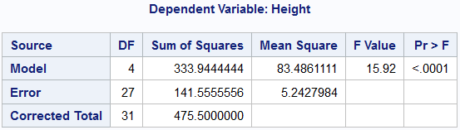
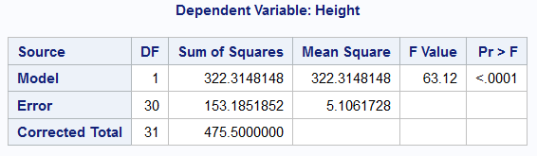
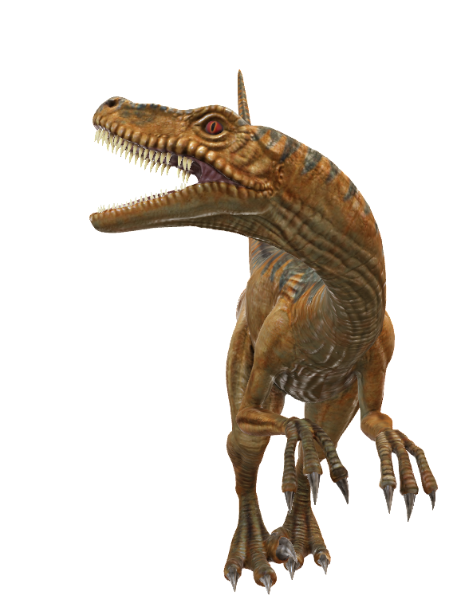
Question 2 Part 3
µ_{B =} µ_{F =} µ_{Soc =} µ_{Swim =} µ_{T}
µ_{B =} µ₀ ₌ µ₀ ₌ µ₀ ₌ µ₀
Source | DF | SS | MS | F | Pr > F
Model | 3 | 11.629 | 3.876 | 0.739 | 0.538
Error | 27 | 141.556 | 5.243
Corrected Total | 30 | 153.185
There is not sufficient evidence to suggest that the mean height of players in soccer, football, swimming, and tennis are different from one another (p-value = 0.538 from ANOVA).

Slide 28
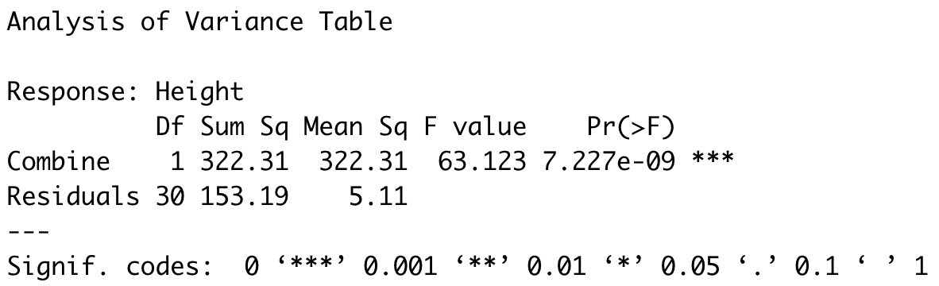
µ_{B} µ_{F} µ_{Soc} µ_{Swim} µ_{T}
µ_{B} µ₀ µ₀ µ₀ µ₀
fit = lm(Height~Sport, data = Sports)
anova(fit)
fit = lm(Height~Combine, data = Sports)
anova(fit)
F-TEST: Another Look
There is not sufficient evidence at the alpha = .05 level of significance (p-value = 0.5375) to suggest that the mean heights of non-basketball sports are not equal. Therefore we will proceed as if they are equal.
H₀: Reduced Model: µ_{B} µ₀ µ₀ µ₀ µ₀
H_{a}: Full Model: µ_{B} µ_{F} µ_{Soc} µ_{Swim} µ_{T}
Source | DF | SS | MS | F | Pr > F
Model | 3 | 11.63 | 3.87 | .74 | 0.5375
Error | 27 | 141.56 | 5.24
Corrected Total | 30 | 153.19

Slide 29
Since we are proceeding under the assumption that the mean heights of the other sports (besides basketball) are equal, we can test whether basketball has a mean height different than the other sports by testing:
H₀: µ_{Basketball} = µ_{Others}
H_{a}: µ_{Basketball} ≠ µ_{Others}
There is strong evidence at the alpha = .05 level of significance (p-value < .0001) that supports the claim that the mean height of basketball players is different than that of the other 4 sports.

Slide 30

Why Include $μ_{B}$ in Both Ho and Ha?

Slide 31
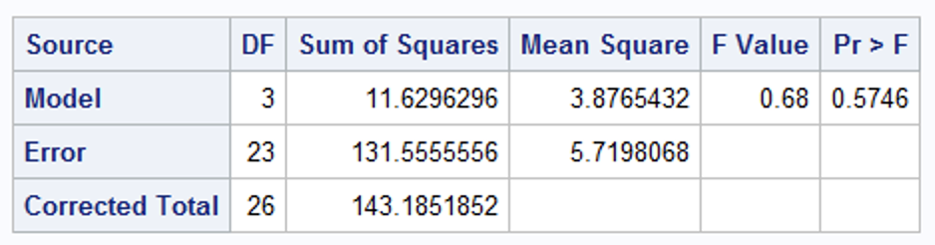
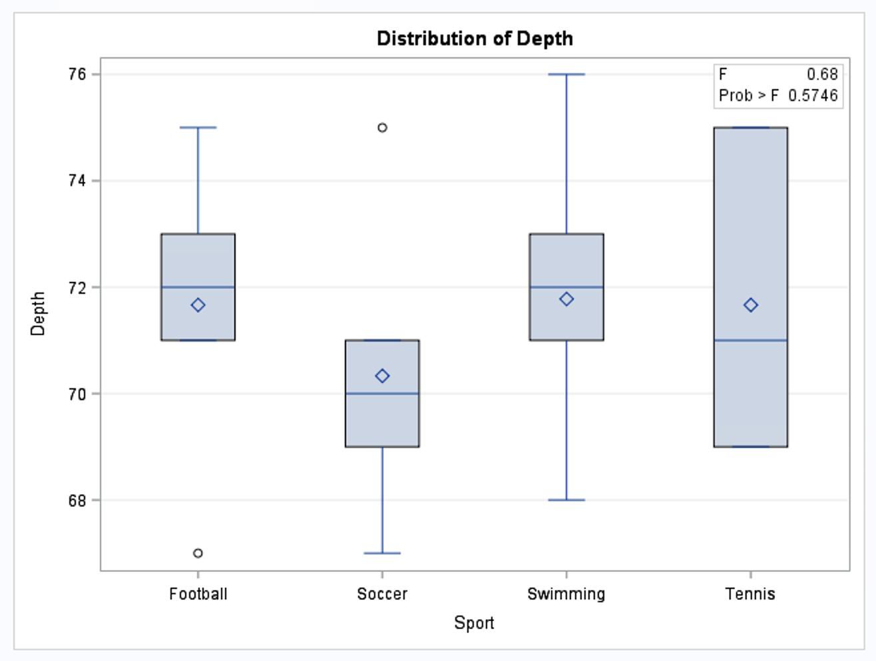
H₀: Reduced Model: µ_{B} µ₀ µ₀ µ₀ µ₀
H_{a}: Full Model: µ_{B} µ_{F} µ_{Soc} µ_{Swim} µ_{T}
There is not sufficient evidence at the alpha = .05 level of significance (p-value = 0.5375) to suggest that the mean heights of non-basketball sports are not equal. Therefore we will proceed as if they are equal.
Source | DF | SS | MS | F | Pr > F
Model | 3 | 11.63 | 3.87 | .74 | 0.5375
Error | 27 | 141.56 | 5.24
Corrected Total | 30 | 153.19
Compare to running an ANOVA without the basketball heights. This would compare the F, Soc, Swim and Tennis groups as intended…. But….
proc glm data = Height;
class Sport;
where Sport <> "Basketball";
model Depth = Sport;
run;
In the top table we are using the basketball data to get a better estimate of the COMMON standard deviation (since we assumed they were all the same.). This is reflected in the increase in the degrees of freedom for the Error which will give the top test more power.

Slide 32
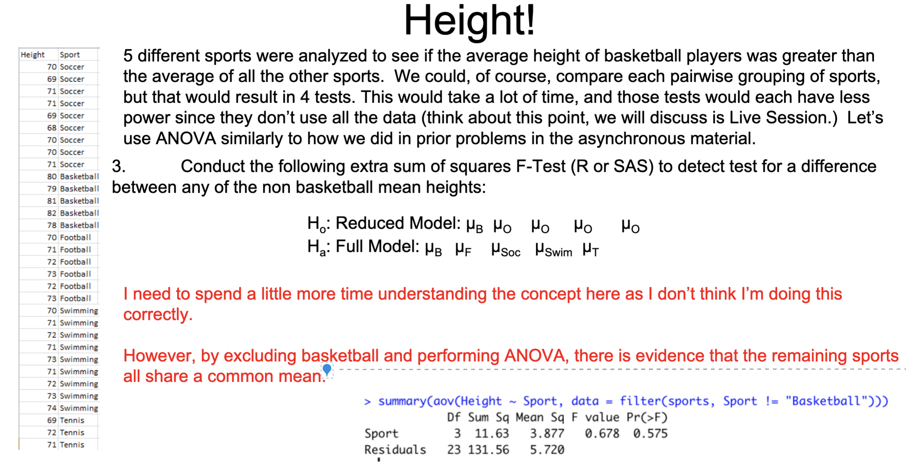

Slide 33
End Question 2

Slide 34
Question 3

Slide 35
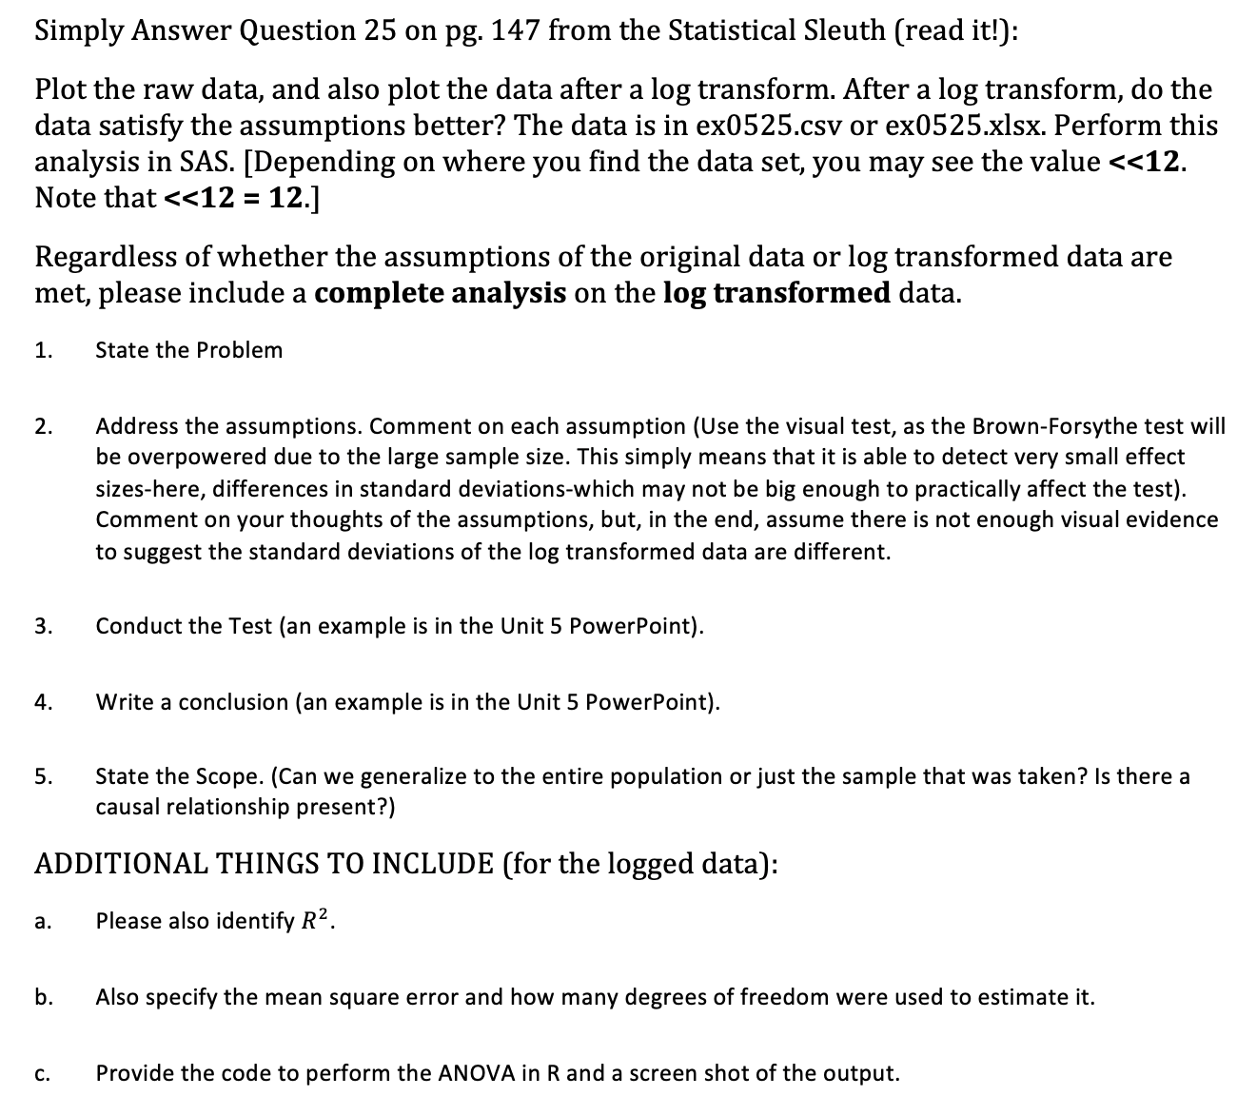
Question 3

Slide 36
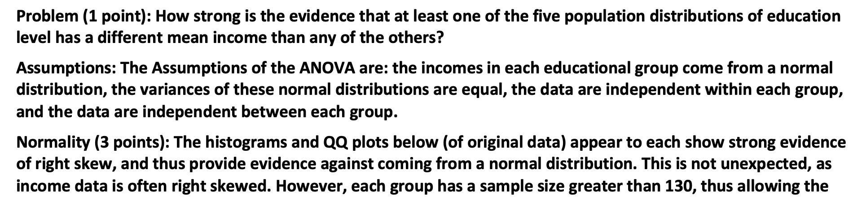
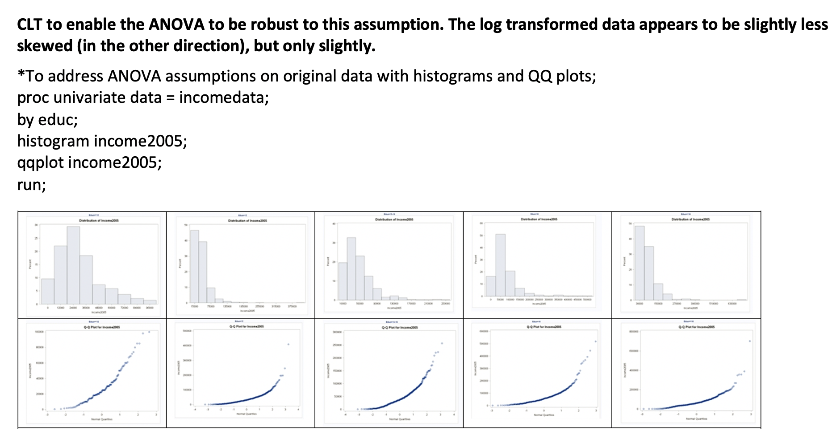
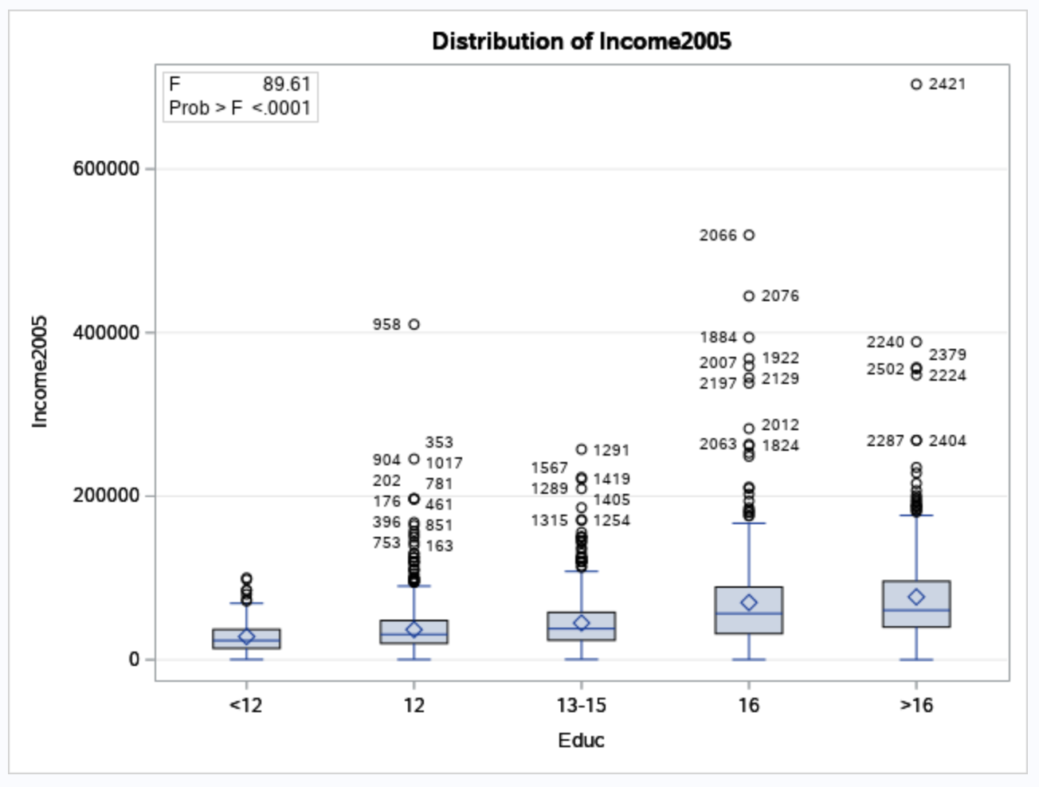
Question 3
*ordering data by Educ by creating a column called EO;
data income;
set income;
if Educ eq '<12' then EO = 1;
if Educ eq '12' then EO = 2;
if Educ eq '13-15' then EO = 3;
if Educ eq '16' then EO = 4;
if Educ eq '>16' then EO = 5;
run;
proc sort data= income;
by EO;
run;
*ANOVA;
proc glm data = income order= DATA;
class Educ;
model income2005 = Educ;
run;

Slide 37
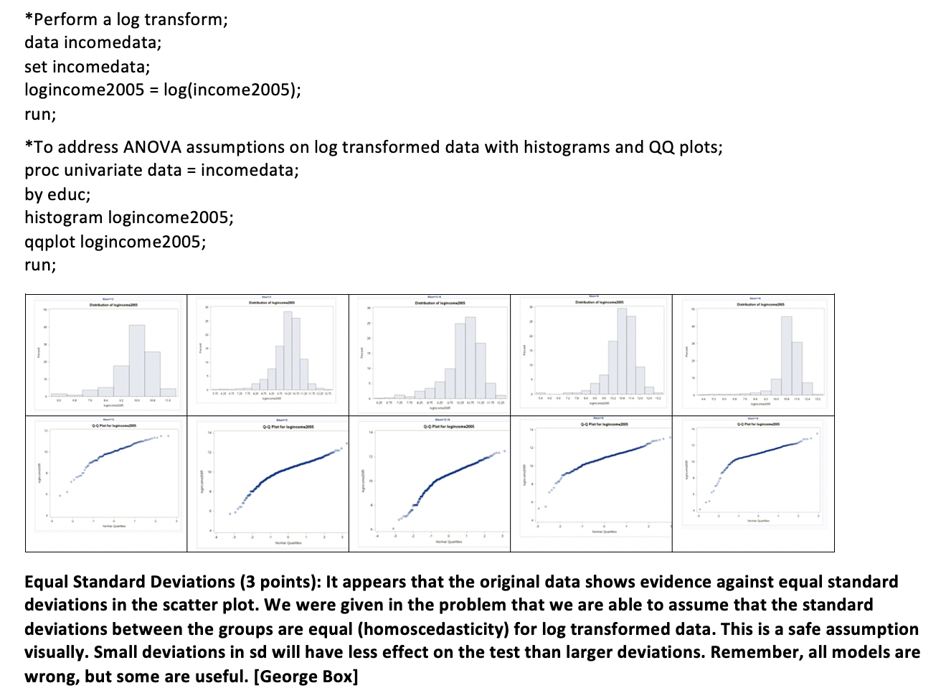
Question 3
proc sort data= incomedata;
by EO;
run;
*ANOVA;
proc glm data = incomedata order= DATA;
class Educ;
model logincome2005 = Educ;
run;

Slide 38
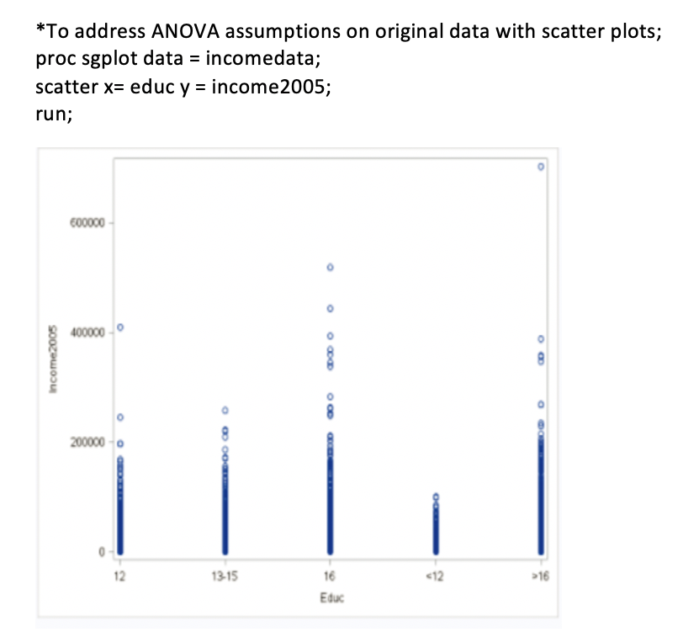
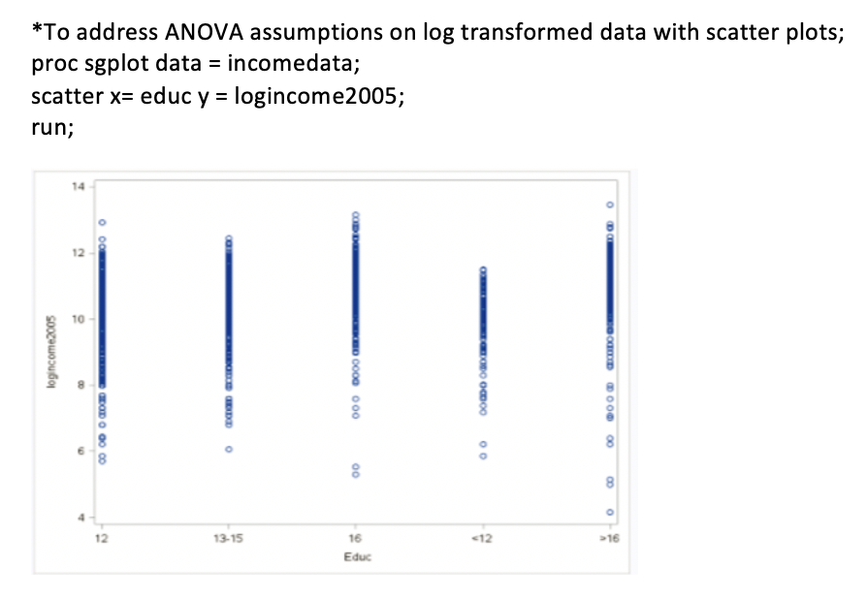
Question 3

Slide 39

Question 3
https://www.nlsinfo.org/content/cohorts/nlsy79/intro-to-the-sample/sample-design-screening-process.

Slide 40
Question 3

Slide 41

Question 3

Slide 42

Question 3

Slide 43


Question 3

Slide 44

Question 3

Slide 45



KW Approach!
$$Ho:All group medians are equal.$$
$$Ho:At least one pair of group medians are different.$$
Critical Value from a chi square distribution with 4 degrees of freedom is: 9.487729
Test Statistic = 349.45
Pvalue < .0000000001
Decision: Reject Ho
There is overwhelming evidence at the .05 level of significance to suggest that at least one pair of median comes are different (pvalue from a Kruskal Wallis test < .0000001).

Slide 46


ChatGPT Approach

Slide 47






ChatGPT Approach
!
!!!

Slide 48

ChatGPT Approach
It is looking at a subset of the data… this is easily solved in time.
!

Slide 49
End Question 3

Slide 50
Extra Practice Used to be a Breakout Long Ago…

Slide 51
Plant Growth Experiment
The data in the PlantGrowth dataset are results from an experiment to compare yields (as measured by dried weight of plants) obtained under a control and two different treatment conditions.
Your goal is to detect any difference in the location of the distribution of weights between the control group and the two treatment groups (mean or median).

Slide 52
Plot the Data!
PlantGrowth %>%
ggplot(aes(x = weight, color = group)) + geom_histogram() +
facet_wrap(~group)
PlantGrowth %>%
ggplot(aes(sample = weight, color = group)) + geom_qq() +
geom_qq_line() +
facet_wrap(~group)

Slide 53



Conduct the KW Test!
kruskal.test(weight~group, data = PlantGrowth)
$$Ho:All group medians are equal.$$
$$Ho:At least one pair of group medians are different.$$
Critical Value from a chi square distribution with 2 degrees of freedom is: 5.991465
Test Statistic = 7.9882
Pvalue = .01842
Decision: Reject Ho
There is sufficient evidence at the .05 level of significance to suggest that at least one pair of medians are different (pvalue from a Kruskal Wallis test of 01842).

Slide 54
Conduct the KW Test!
proc npar1way data = PlantGrowth Wilcoxon;
class group;
var weight;
run;
$$Ho:All group medians are equal.$$
$$Ho:At least one pair of group medians are different.$$
Critical Value from a chi square distribution with 2 degrees of freedom is: 5.991465
Test Statistic = 7.9882
Pvalue = .01842
Decision: Reject Ho
There is sufficient evidence at the .05 level of significance to suggest that at least one pair of medians are different (pvalue from a Kruskal Wallis test of 01842).

Slide 55
Further Research!
Since there is evidence that at least one median is different between the groups, we would like to find out which groups have significantly different medians and provide an estimate of the difference(s)! What would you do?

Slide 56



3 Rank Sum Tests
a = PlantGrowth %>% filter(group != "trt2")
wilcox.test(a$weight~a$group)
a = PlantGrowth %>% filter(group != "trt1")
wilcox.test(a$weight~a$group)
a = PlantGrowth %>% filter(group != ”ctrl")
wilcox.test(a$weight~a$group)

Slide 57









3 Rank Sum Tests
$$Ho:Median_{ctrl}=Median_{trt1}$$
$$Ho:Median_{ctrl}=Median_{trt2}$$
$$Ho:Median_{trt1}=Median_{trt2}$$
$$Ho:Median_{ctrl}≠Median_{trt1}$$
$$Ho:Median_{ctrl}≠Median_{trt2}$$
$$Ho:Median_{trt1}≠Median_{trt2}$$
proc npar1way data = PlantGrowth Wilcoxon;
where group <> "trt2";
class group;
var weight;
run;
proc npar1way data = PlantGrowth Wilcoxon;
where group <> "trt1";
class group;
var weight;
run;
proc npar1way data = PlantGrowth Wilcoxon;
where group <> ”ctrl";
class group;
var weight;
run;

Slide 58
Visually Comparing the Distributions
PlantGrowth %>% ggplot(aes(y = weight, color = group)) +
geom_boxplot() +
ggtitle("Comparing the Distributions: Ctrl, TRT1 and TRT2")

Slide 59


Visually Comparing Distributions of the Ranks
https://support.sas.com/documentation/onlinedoc/stat/142/npar1way.pdf
proc npar1way data = PlantGrowth Wilcoxon;
class group;
var weight;
run;

Slide 60
End Breakout

Slide 61
Question 4: Takeaways!
Please provide at least 4 takeaways from this section and any questions that you may have. These questions will help design the live session for this unit.
This question will be the last question of every For Live Session Assignment. The idea is that this deck will serve as a document that you can reference in the future to remember what was covered in this section. For instance, this may come in handy for the Capstone and will hopefully become useful in your career. Most immediately, it may become handy as a quick reference for your Midterm and Final! Some students find it very useful and spend a few slides summarizing the asynch material while others learn different ways and only had the minimum 4 takeaways. Either is fine and will earn you full credit for this question.

Slide 62
Question 5: Questions!
Please provide any question or topics of discussion that came up in this Unit! These will help help us optimize our live session for maximum learning and takeaways!
This question will be the last question of every For Live Session Assignment. The idea is that this deck will serve as a document that you can reference in the future to remember what was covered in this section. For instance, this may come in handy for the Capstone and will hopefully become useful in your career. Most immediately, it may become handy as a quick reference for your Midterm and Final! Some students find it very useful and spend a few slides summarizing the asynch material while others learn different ways and only had the minimum 4 takeaways. Either is fine and will earn you full credit for this question.

Slide 63
Useful Resources
SAS proc Power Info
https://support.sas.com/documentation/onlinedoc/stat/141/power.pdf

Slide 64
End For Live Session Assignment Unit 6!

